Slide 1

GCP Organization Structure: Projects, Accounts, Roles & Identities
This presentation explores how Google Cloud Platform (GCP) organizes its resource hierarchy, accounts, roles, and identities to deliver secure and scalable access management. We will dissect GCP’s foundational structure, illustrating how organizations leverage projects as core units while managing access through IAM roles assigned to various identities. Understanding this architecture is essential for designing effective cloud governance and security models for enterprise environments.
By Ashwin Kumar

Slide 2

GCP Resource Hierarchy
Organization (Root Node)
Folders (Optional)
Projects (Core Units)
Resources
Actual cloud services and assets such as VM instances, storage buckets, and databases that operate within projects.
Represents the company entity, such as your domain (e.g., org.com). It is the top-level node in the hierarchy, centralizing policy and billing administration.
Logical containers grouping projects, often aligned to departments like IT or Finance, facilitating delegation and policy inheritance.
The primary boundary for resources, billing, API enablement, and access control. Projects encapsulate resources like Compute Engine and BigQuery datasets.

Slide 3
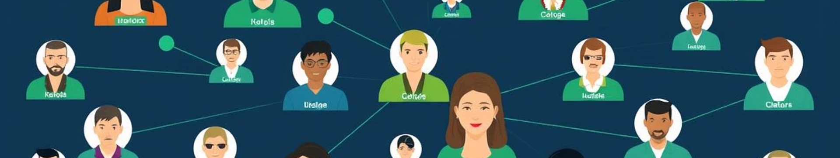
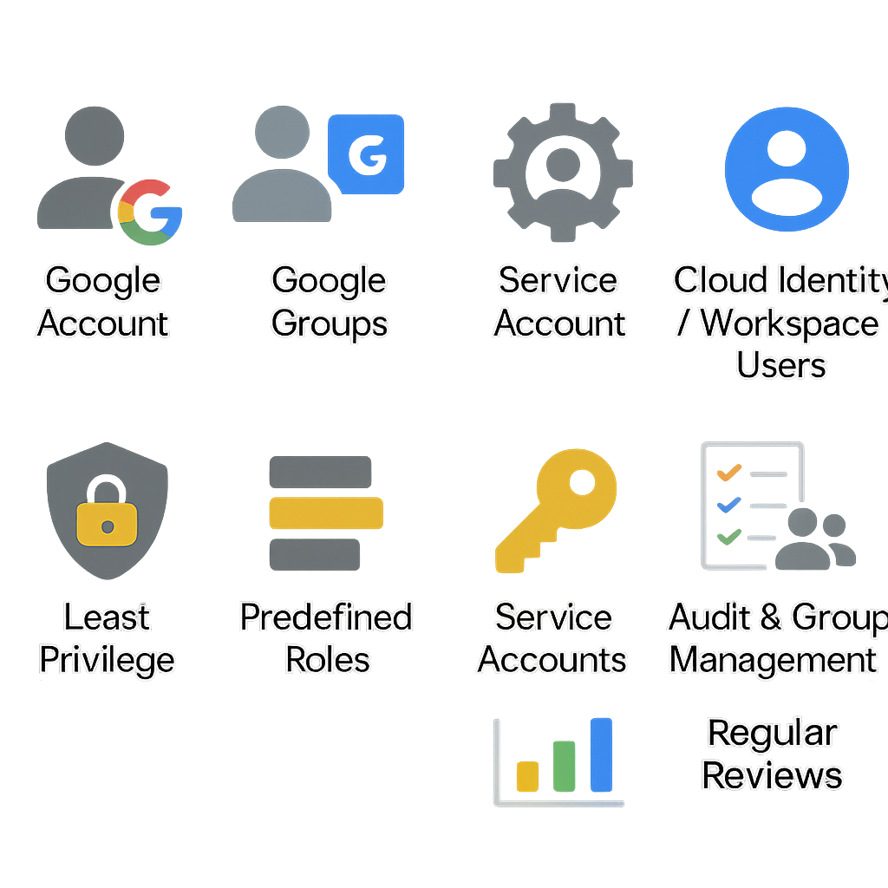
GCP Identity Types
Google Account
Service Account
Single-user identities, such as individual email accounts (user@example.com) representing end users.
Non-human identities for applications or services to authenticate and access GCP resources securely.
Google Groups
Cloud Identity / Workspace Users
Collections of user accounts that simplify access management by assigning roles to groups instead of individuals.
Enterprise-managed user accounts managed via Cloud Identity or Google Workspace, including both internal employees and external partners.

Slide 4
GCP IAM Roles Overview
Primitive Roles
Predefined Roles
Custom Roles
Owner: Full control over all resources
Specific to GCP services (e.g., BigQuery Data Editor, Compute Admin)
User-defined collection of permissions
Editor: Modify most resources
Allows precise control fulfilling unique organizational policies
Viewer: Read-only access
Offer granular access tailored to service requirements

Slide 5
IAM Policy Binding
Policy Structure
Inheritance Model
An IAM policy defines bindings mapping members (identities) to roles on resources. Example syntax shows bindings with roles and members.
Policies can be applied at any hierarchy level (organization, folder, project, or resource). Permissions cascade downward, allowing centralized management.

Slide 6
GCP Projects: Central Management Unit
Billing & Services
Access Control & Monitoring
Projects serve as billing containers; billing accounts are linked at this level. APIs and services are enabled per project to control resource usage.
IAM policies manage project-level access, while quotas, logs, and monitoring metrics are collected per project to ensure efficient operations.

Slide 7
GCP IAM Best Practices
Least Privilege
Predefined Roles
Service Accounts
Grant only the necessary permissions to users and service accounts to minimize risk.
Use predefined roles where possible to leverage Google’s curated permission sets.
Use service accounts for automated workflows and avoid using user accounts for automation.
Audit & Group Management
Regular Reviews
Enable Cloud Audit Logs for monitoring and use groups to simplify role management for multiple users.
Periodically review and update IAM policies to maintain security posture.

Slide 8
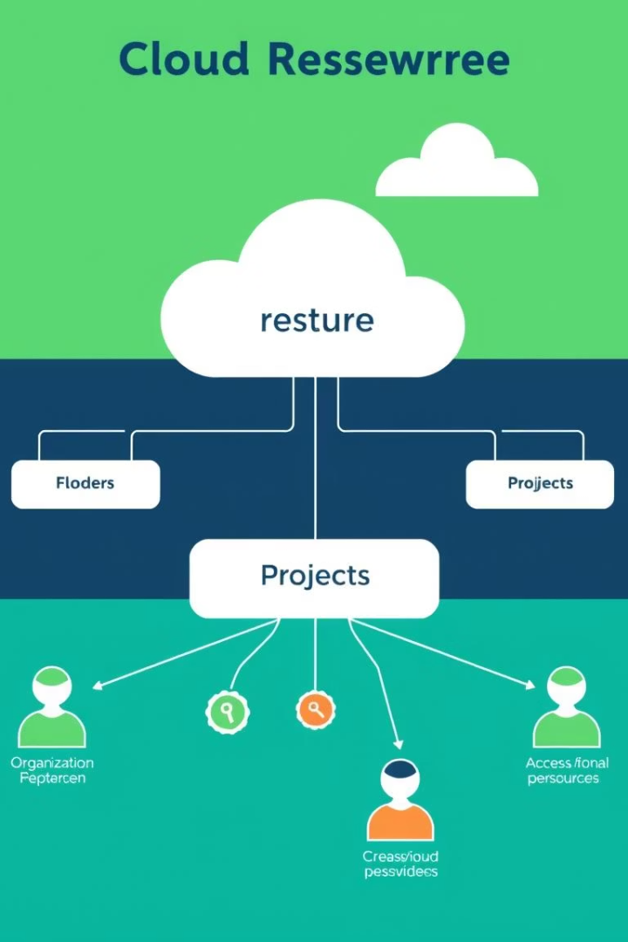
Key Takeaways
Hierarchical Model
Resources are structured in Organization, Folders, Projects, and Resources layers.
Identity Types
Supports users, service accounts, groups, and enterprise identities.
Fine-grained Access
IAM roles provide flexible, detailed permission control across resources.
Projects as Units
Projects centralize billing, API enablement, and access control.

Slide 9

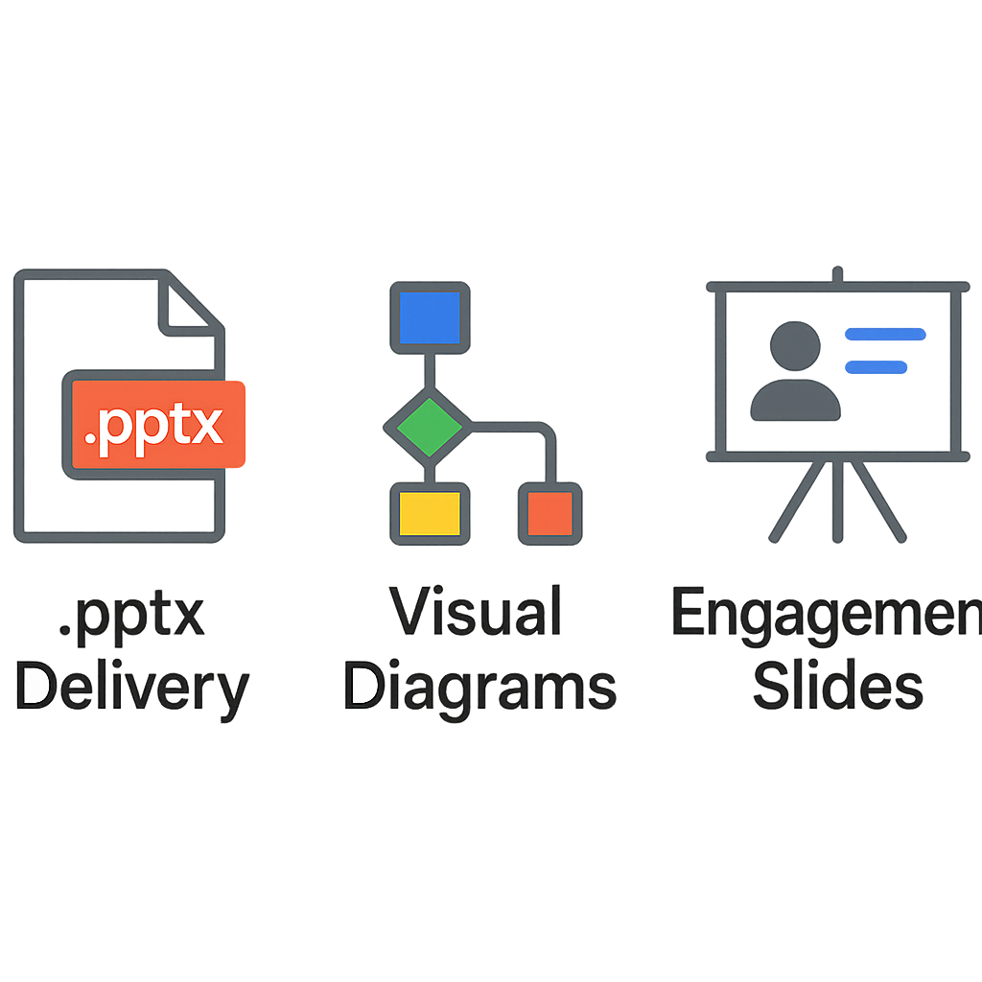
Additional Support Options
.pptx Delivery
Visual Diagrams
Engagement Slides
We can provide the entire presentation in editable PowerPoint format for your convenience.
Include detailed diagrams for complex structures to aid understanding.
Add quiz-based or case study slides to improve interactivity and retention.

Slide 10





Next Steps and Questions
Review
Design
Implement
Monitor
Evaluate current GCP organization and IAM configuration for alignment with best practices.
Develop or enhance access policies using hierarchical roles and identities appropriately.
Apply policies, configure service accounts, and enable audit logging for compliance and security.
Continuously monitor IAM policy use and adjust roles based on operational requirements and audits.

